Slide 1

ERA Mentoring Programme
Carolyn Howitt & Darren Parnell

Slide 2
Career Development & Skill Enhancement
Mentee benefits
Guidance on career path, job roles, transitions, and long-term goals
Setting realistic and achievable career goals
Development of leadership, communication, and problem-solving skills
Hands-on guidance for mastering technical skills
Building a strengths profile to focus on strengths and manage weaknesses

Slide 3
Confidence, Networking & Personal Growth
Mentee benefits
Boost in self-esteem and confidence through strengths
Improved decision-making abilities
Access to mentor's professional network and industry exposure
Emotional support and resilience building
Guidance on work-life balance for a fulfilling life

Slide 4
Productivity
Mentee benefits
Improved workplace performance and productivity
More meaningful performance reviews
Transformative mentoring experience with tools and support to thrive

Slide 5
Benefits of being a mentor
Build coaching skills
Learn about a new organisation/sector
Fresh perspective, keeps you relevant
Develop leadership skills
Job satisfaction
Broaden own network

Slide 6
some topics covered
Celebrate successes
Talk through challenges
Work-life balance
Career planning
Using your strengths
Relationship management
Working according to personal values
Promotion plan
‘Gremlins’
Managing difficult times

Slide 7
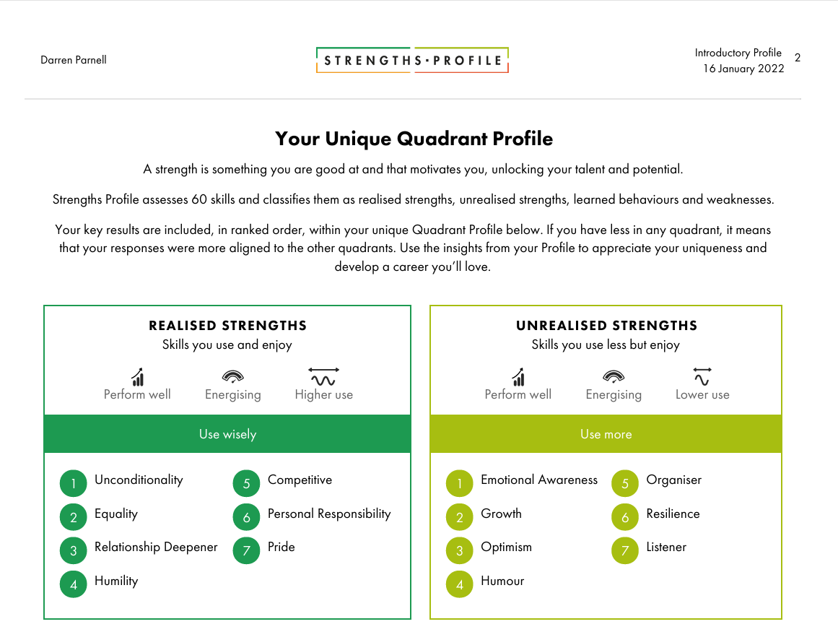
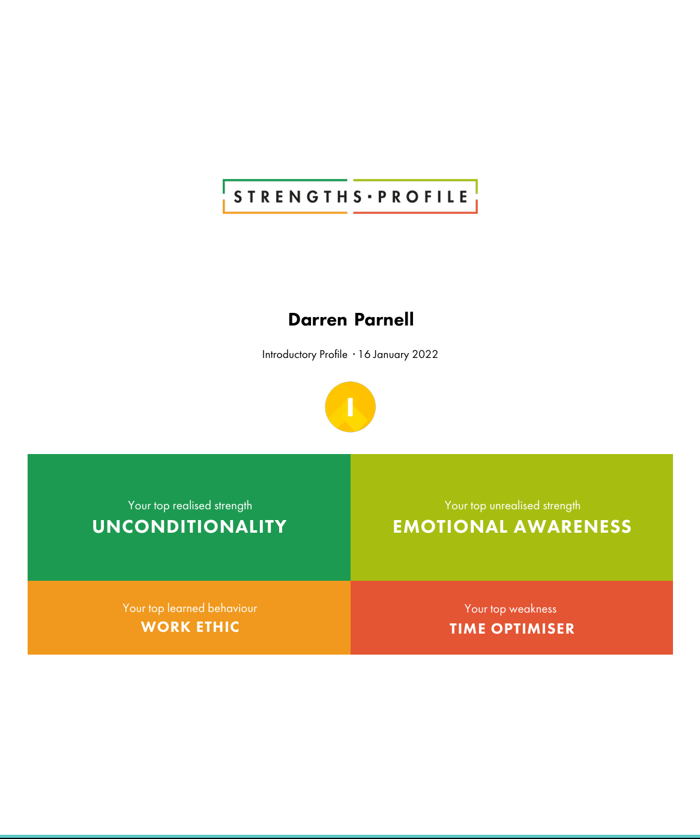
Strengths profile

Slide 8

Success
Being promoted was a meaningful acknowledgment of my value, which has empowered me to be more confident and bolder in my approach. I now work smarter and enjoy a better work-life balance. Having a clearer structure and a deeper understanding of which tasks require my attention most has made a significant difference.

