Slide 1


INSIGHTS TRAINING
Talking about Talent Insight
Delivered by Charlotte Moffatt, Armstrong Craven Ltd
September 2021

Slide 2

CONTENTS
INTRODUCTION | 03
WHY CLIENTS COMMISSION INSIGHT | 04
HOW CLIENTS USE INSIGHT | 05
HOW TO TALK ABOUT/SELL INSIGHT | 06
HOW TO PRESENT INSIGHT TO CLIENTS/DIFFERENT STAKEHOLDERS | 07
TIME FOR QUESTIONS | 09
2

Slide 3
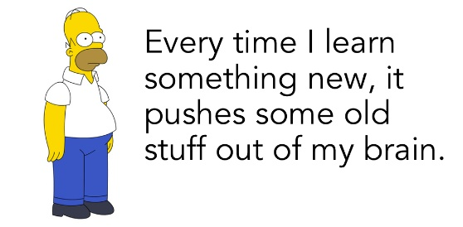
INTRODUCTION
Introduction to Charlotte and her Primary Research role within Armstrong Craven’s Insight & Talent Analytics function
Quick recap of the first Webinar
Introduction to today’s session
  Why clients/internal stakeholders commission insight
  How to talk about/sell insights
  How clients /internal stakeholders use insight
  How to present insight reports to different stakeholders
3

Slide 4

WHY CLIENTS & INTERNAL STAKEHOLDERS COMMISSION
INSIGHT
To make more informed business decisions
For HR/TA to elevate themselves into a more strategic position
Clients unable to do it themselves
Confidentiality (when using an agency)
“Talent Intelligence is the ability to combine and analyse sources of information about the external talent landscape to support business decisions.”
“Phone insight is non-biased, relevant, confidential and real-time data”
4

Slide 5
HOW CLIENTS & INTERNAL STAKEHOLDERS USE INSIGHT
To influence internal stakeholders and make better-informed decisions
Examples:
Uncovering something that they did not know about themselves/their situation
Finding out what really matters to talent
Confirming what a client suspects to be true
But how do we get this insight? Common issues and how to overcome them:
Objection handling from talent
International nuances / sensitivities
Chasing missing data/insight
Personal-level
Career
motivations
Current role,
Team &
Reports
Function-level
Structure &
Reporting lines
Business-level
tech,
capabilities
Commercial intel
£££ Budgets,
Product intel
Safe
territory
Challenging
territory
5

Slide 6

HOW TO TALK ABOUT/ / SELL INISGHT
Listen
Find the clients ‘pain points’
Align it to what you do as a recruiter – it is a shift in mindset, not skillset
Be prepared for a longer sales/decision making process
Once sold take a thorough brief, and relay it back to them. Both sides need clear expectations
6

Slide 7

HOW TO PRESENT INSIGHT REPORTS TO DIFFERENT STAKEHOLDERS
Reporting
Analysis
Storytelling
Different stakeholders/different needs
GDPR refresh
7

Slide 8


TALENT MAP OVERVIEW
Total individuals identified
441
Diversity
16%
Female
Location
 | Back-End | Front-End | Total
Hyderabad | 344 | 54 | 398
Mumbai |  | 35 | 35
Bangalore |  | 6 | 6
Nagpur |  | 1 | 1
Gurgaon |  | 1 | 1
Years of experience
8

Slide 9


TIME FOR QUESTIONS
charlotte.moffatt@armstrongcraven.com

