Slide 1
“All work is a deal, a compromise between what you want out of life and what an employer wants to get out of you.”
John Lees
Carolyn Howitt
carolyn@careerpathcounselling.co.uk
Carolyn Howitt | LinkedIn
Twitter - @CareerPathUK

Slide 2
Introductions
First name
What you do
Where you are – town/location, country
One thing you can see out of the window

Slide 3
Today
Bit of background to Work Motivations
Complete the exercises
Discuss results
Look at Motivations within search/recruitment/talent acquisition

Slide 4
1980s Edward Deci and Richard Ryan
Positive factors (‘direct’ motives)
1. Play - the work is engaging, enjoyable, it makes you creative and curious. 2. Purpose - the work has a clear goal. 3. Potential – you can grow with your job and fit your identity to it.
Negative factors (‘indirect’ motives) 4. Emotional pressure – fear, peer pressure, shame: your identity is threatened if you don't do it. 5. Economic pressure – to gain a reward or avoid a punishment. 6. Inertia – you no longer know why you are doing it, but it's familiar.

Slide 5
Extrinsic work motivations, eg:
Environment
Pay, rewards
Work/life balance
Supportive manager/team
Promotion
Intrinsic work motivations, eg:
Personal and professional growth
Autonomy
Freedom of expression
Gaining a skill
You can see the benefit of your work

Slide 6
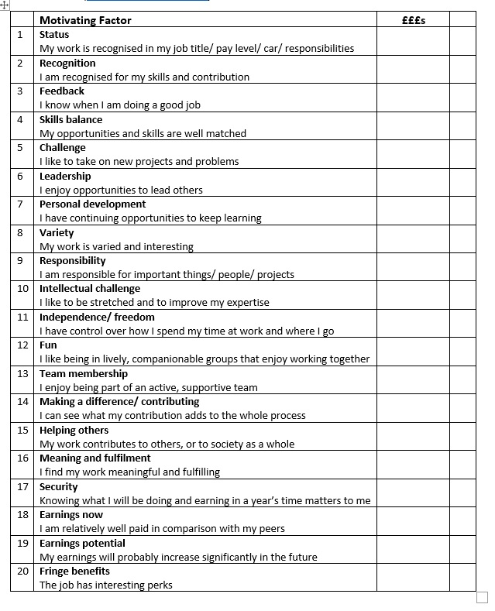

Slide 7
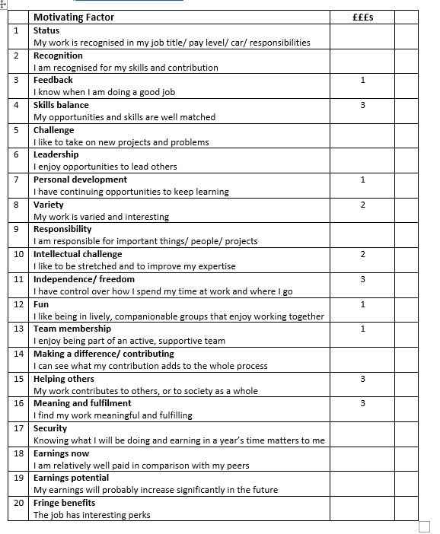
Carolyn - all motivations

Slide 8
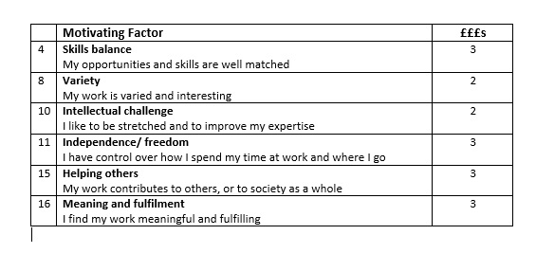
Carolyn Motivations above £2

Slide 9
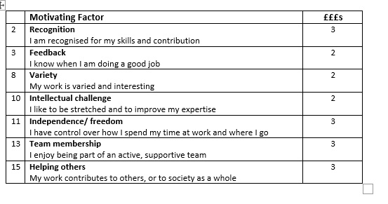
Me last week
Me when a junior researcher

Slide 10
Results time!

Slide 11
On your printout, write down your top Motivators (those scoring 2 or more). In the blank right-hand column mark how well your current role provides you with these.
Mark each one either:
A - Always Need always (or usually) met
O - Often Need often met
S - Sometimes Need sometimes met
N - Never Need never met

Slide 12
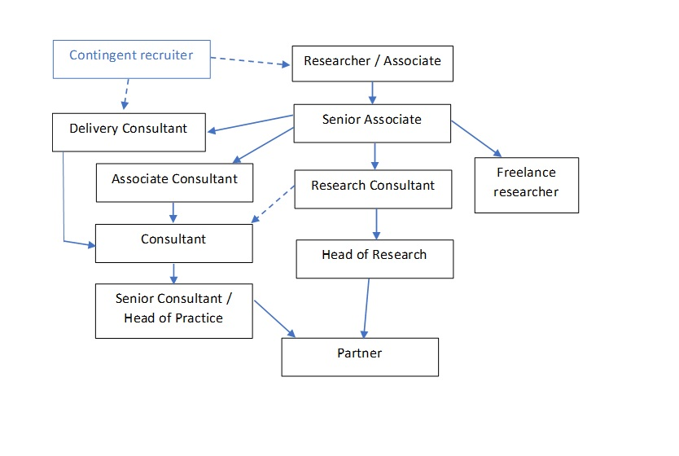

Slide 13
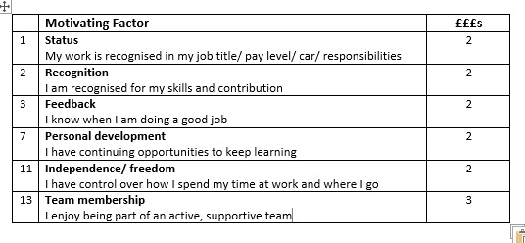
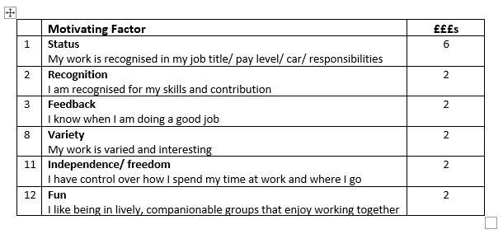
A.
One of these is MD of a medium-sized retained search firm.
One is a Senior Career Researcher.
Which do you think is which?
B.

Slide 14
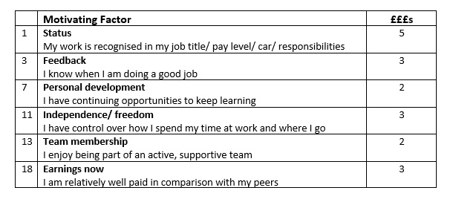
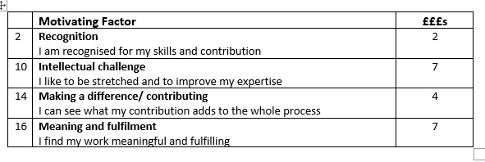
A.
Two ex-researchers who are currently leaving search:
One to be a Data Science Client Lead.
One to train as a Jungian Psychoanalyst.
B.

Slide 15
Finally..
Look at your highest-scoring Motivators.
Think of a time when one of these was met at work.
Frame it into a positive Motivators story.

Slide 16
More information:
www.careerpathcounselling.co.uk/resources
Career paths within executive search
Salary checker
Thinking of leaving search/recruitment?
https://www.linkedin.com/pulse/50-ways-leave-executive-search-carolyn-howitt
More coming up about this on the Resources page

