Slide 1
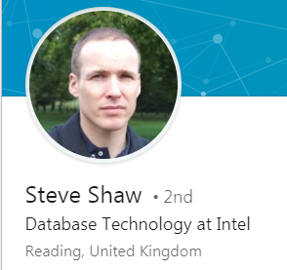
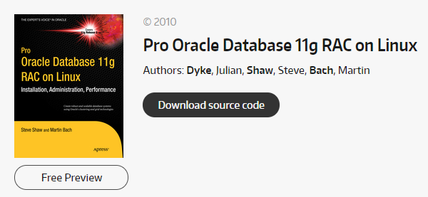
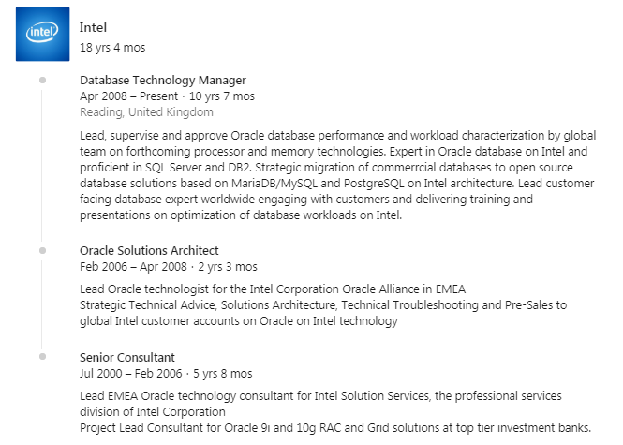
My lightbulb moment

Slide 2
“candidates” everywhere now Active users (millions) July 2018

Slide 3
One thing in (un)common ?

Slide 4
Sites Supporting Boolean Search (AND, OR, NOT, “”)
 | Objects to Search | Site | Advanced Search | Paid? | Search Operators (other than AND OR NOT)? | Wildcard?
Google | Webpages | google.com | https://www.google.com/advanced_search | no | yes | no
Bing | Webpages | bing.com | no | no | yes | no
LinkedIn | Member Profiles | linkedin.com | https://www.linkedin.com/vsearch/p?adv=open | some | no | no
Twitter | Tweets, Profiles | twitter.com | https://twitter.com/search-advanced | no | yes | no
Zoominfo | Aggregated Profiles | zoominfo.com | http://www.zoominfo.com/s/#search/person | yes | no | no
Zoominfo | Companies |  | http://www.zoominfo.com/s/#!search/company | no | no | no
Indeed.com | Resumes | indeed.com | http://www.indeed.com/resumes/advanced | no | yes | yes
HiringSolved | Aggregated Profiles | hiringsolved.com |  | yes | yes | yes
Talentbin by Monster | Aggregated Profiles | talentbin.com |  | yes | yes | yes
OpenWeb by Dice | Aggregated Profiles | dice.com/openweb |  | yes | yes | yes
Entelo | Aggregated Profiles | entelo.com |  | yes | yes | yes

Slide 5
Our options - learn or buy

Slide 6
Do you have a recruiting stack?

Slide 7
“if you recruit like a robot – you’ll be replaced by a robot”

Slide 8
What technology can’t do …
Be creative
Pick up the clues
Recognise a problem, put two or three tools together to solve it.
(You still need recruiters / sourcers who think & care)

Slide 9
This can now be automated. Is this how your teams currently source & message ?
SEARCH
MESSAGE

Slide 10
Introducing people.camp (Alternative LinkedHelper )
Free trial available
Message or connect
Personalise
Avoids LinkedIn “problems” by pausing between profile visits.

Slide 11
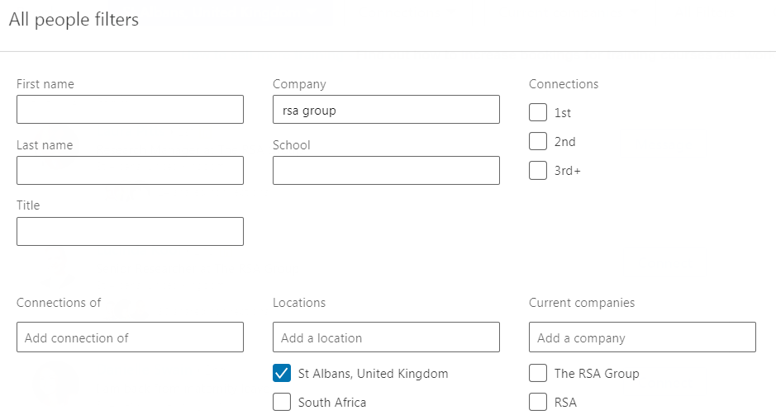
Start with a regular search

Slide 12
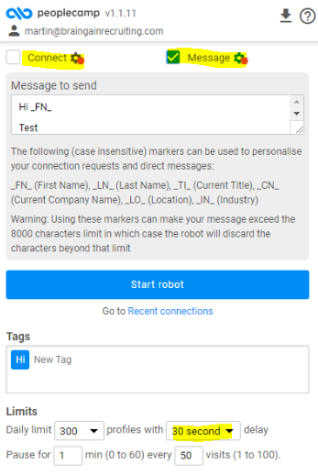
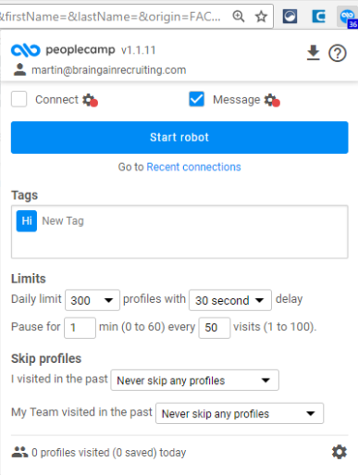

Slide 13
Sits within Linkedin, does not violate terms

Slide 14
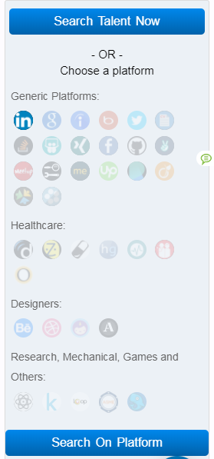
Click to activate search within
Builds a search string
Choose a platform
(or search engine)

Slide 15
X-ray’s using Google or Bing. Watch the string length though (32 word limit)

Slide 16
Job description parser – paid

Slide 17
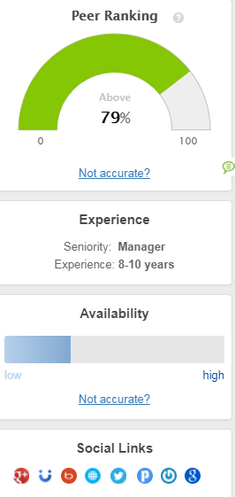
Click within an individual profile to reveal
Contact details
Add to folder, project list
Key skills
Peer ranking
Years of experience
Availability likelihood (?)
Other Social links (ways of contacting / matching)

Slide 18
Also sits within Facebook

Slide 19
And other sites (like Github)

Slide 20
Create projects. Import / export. A real Linkedin replacement contender

Slide 21
Old school with new school

Slide 22
Sourcing is about being creative. CV’s are in PDF because LinkedIn bought Slideshare
You can’t search for this from within LinkedIn

Slide 23
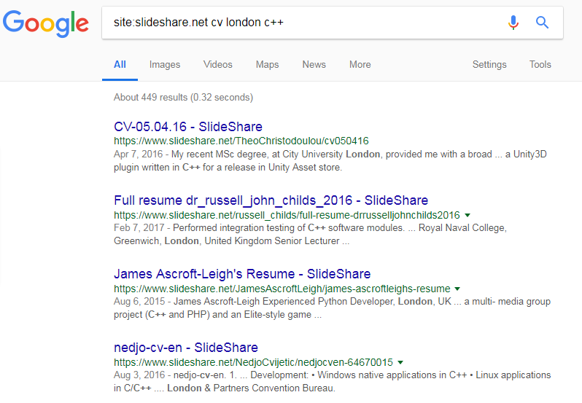
By using site: we can explore

Slide 24
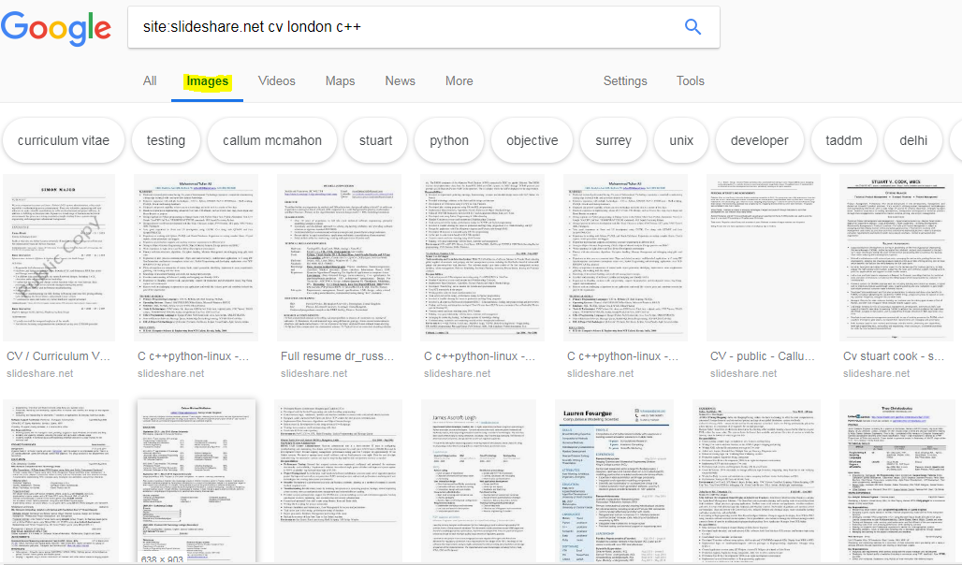
Kind of fun but a real treasure trove.

Slide 25
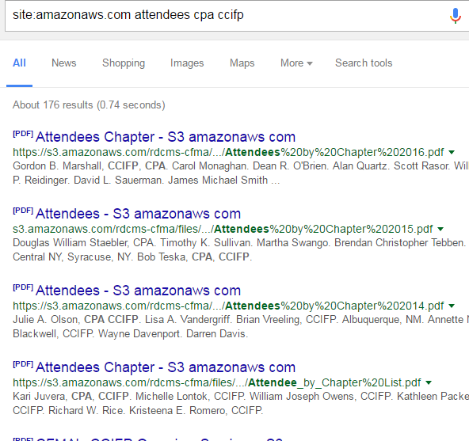
Example: Search for Uploaded Documents (Amazon Cloud)
site:amazonaws.com
attendees cpa ccifp

Slide 26
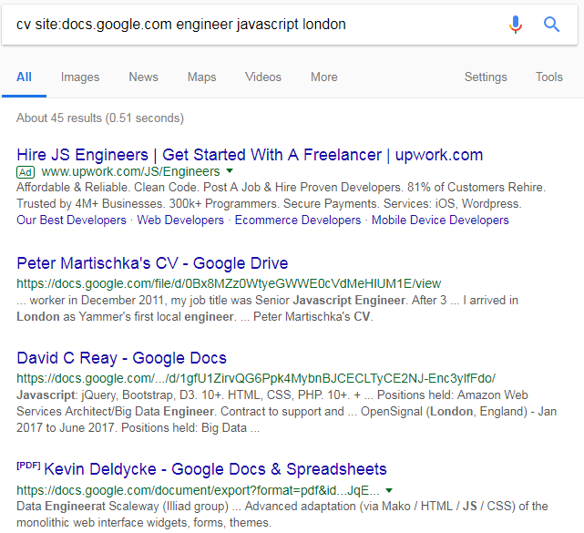
Example: Search for Uploaded Documents (Google Docs)
cv site:docs.google.com engineer javascript london

Slide 27
Wordpress (30% of the top 10 million websites are powered by)

Slide 28
There are many “shallow” profiles. Linkedin V Indeed example.

Slide 29
Knowing how sites work

Slide 30
Where else can we find them ? (Do you ask them?)
Other SM sites (Facebook, Twitter, G+, Instagram etc)
Professional Associations
License / Certification Lookups
Online Forums / Communities / Blogs / Mailing Lists
Meetups / Conferences / Events
Company Websites
People Finder Sites
Resume Sites / Document Storage
“Interested in” Ebay, Amazon, YouTube etc

Slide 31
Youtube – why not ? Comments & speakers

Slide 32
Still clunky, depends on the words you enter.
Notes:
You can ask. Where do they live, job / employer, likes, groups, check ins, age, male/female

Slide 33
Fortunately there are tools (100% free)

Slide 34
Demogrpahic – Northampton, middle aged, Part Time.

Slide 35
Too much noise ?
Revealing about personality, opinions, associates, activity.
You don’t need any followers to search.
Search by location, subject, job seekers, competitors / followers.
Conferences and attendees
Great to be sociable and communicate.

Slide 36
Simple search to find conferences

Slide 37
The conversations and people attending

Slide 38
There are lists and followers and following……..and so it goes on

Slide 39
Twitter tool (there are 100’s) https://tinfoleak.com

Slide 40
Hashtags

Slide 41
User mentions (mostly sourcers)

Slide 42
Google The first door to find the other doors.

Slide 43
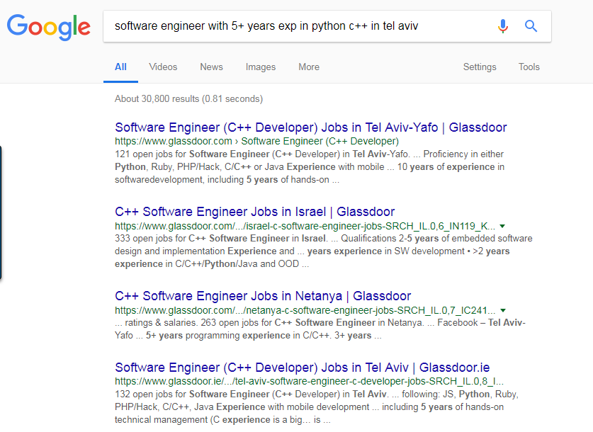
Unfortunately this doesn’t work. Non-traditional resources require non-traditional search.

Slide 44
Additional Boolean search options via Google operators and syntax). i.e. * site: inurl: intitle: ext: there are many others Imagine what you are trying to find. Filter by timeline, country, exact terms or let Google help you.

Slide 45
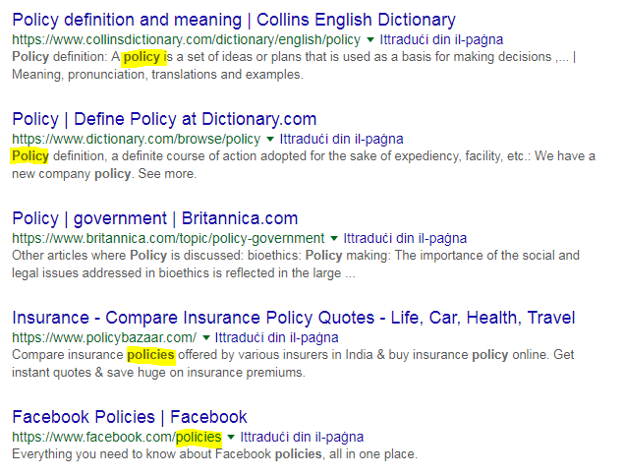
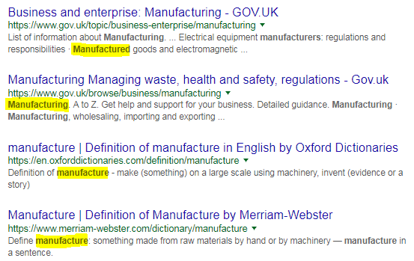

Slide 46
* Meaning “fill in the blanks”

Slide 47
Imagine what you are trying to find

Slide 48
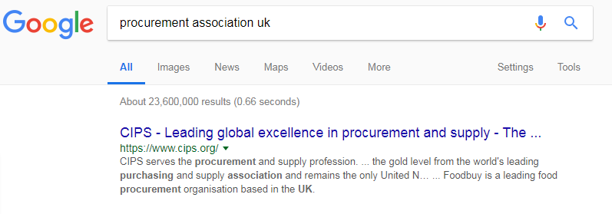
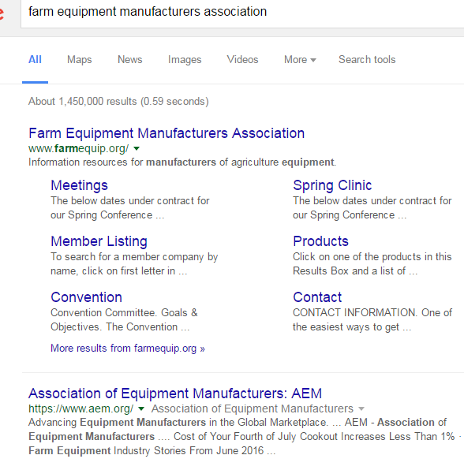
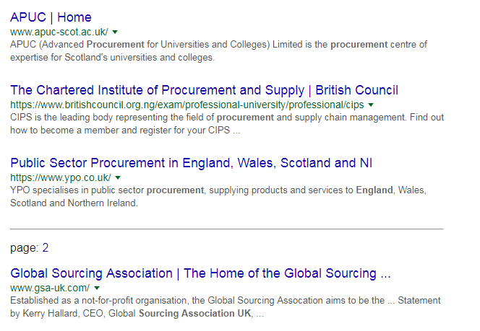
Association Search
Always start simple.
Just to see what you find.

Slide 49
Example: Member Directory found on Association Site

Slide 50
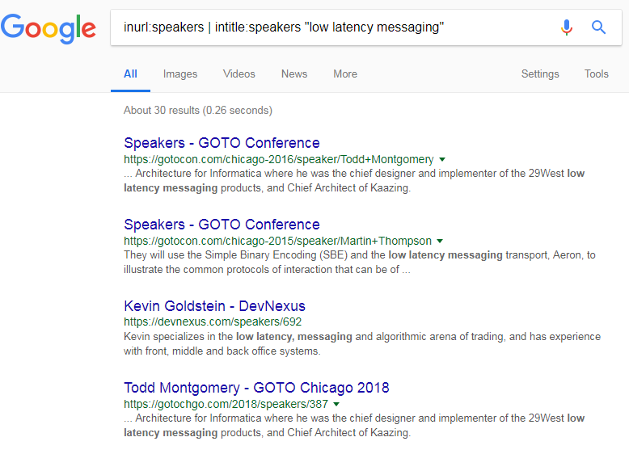

Slide 51
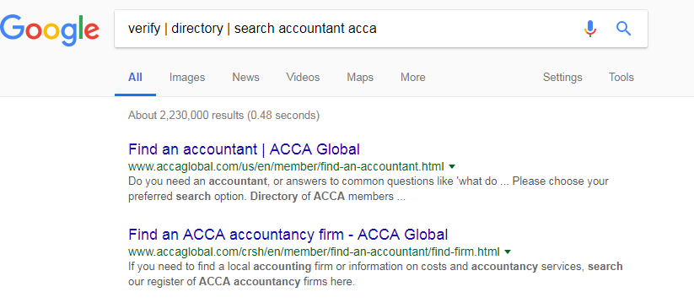
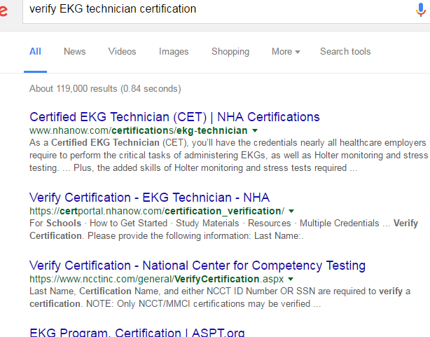
Certifications & Licenses
To find certification or license holders, search for verify, directory, or search

Slide 52
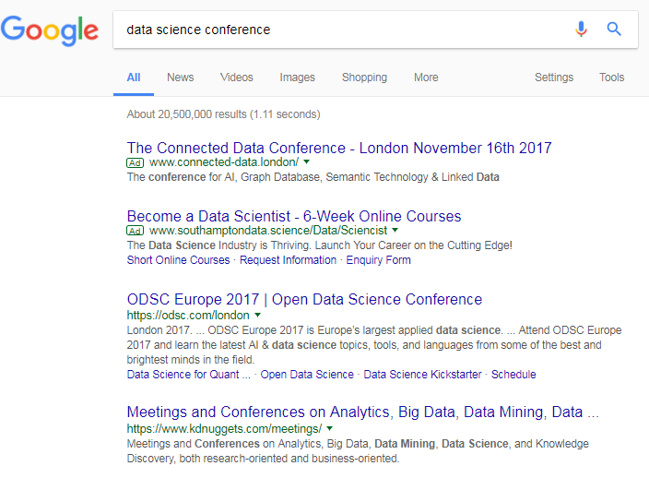
Conferences & Events
Again a simple search
Conference sites
Allconferences.com
Sched.org
Lanyrd.com
Meetup.com

Slide 53
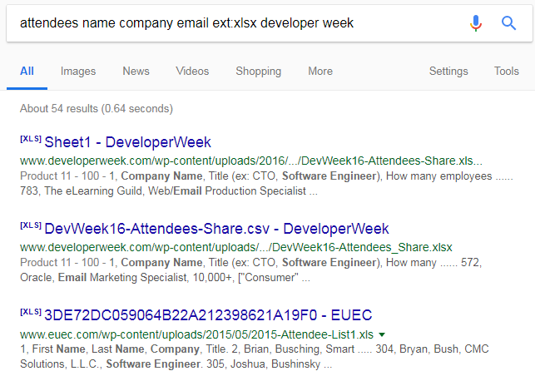
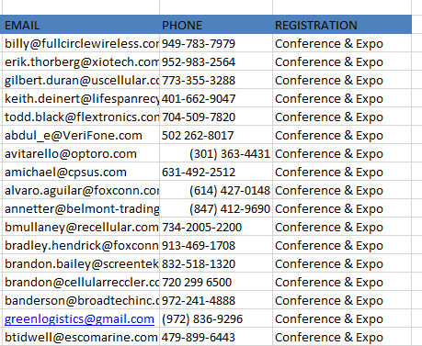
Example: Googling for Attendee Lists

Slide 54
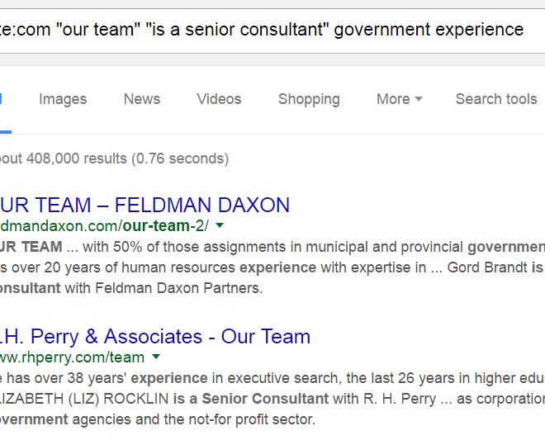
Finding Company Websites
Search for what you expect to find
Look for phrases / words common across multiple sites

Slide 55
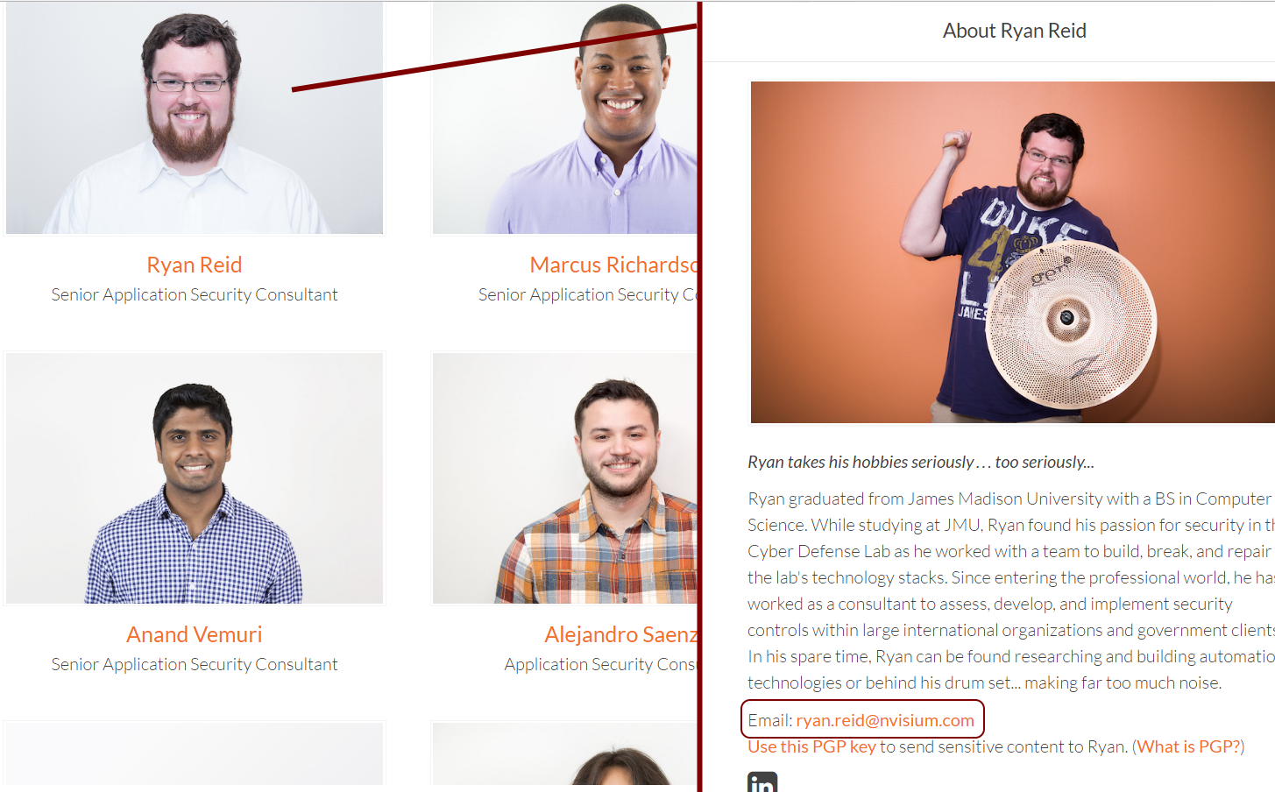
Company Websites – Desired Result

Slide 56
Summary
Don’t think out of the box, there should be no box in the first place.
Learn Google (& Bing) + Boolean
Imagine what you are trying to find.
Practice makes almost perfect.
Be creative.

