Slide 1
Pipeline Power
Marketing Strategies to Attract
and Win New Business Presented by: Heidi Braun and Julie Travers September 25, 2024

Slide 2
About Cluen
Founded in 1990
Global provider of Executive Search Software solutions
Used by Executive Search Firms and In-House Search/Sourcing Teams
Tens of thousands of users worldwide
Notes:
Cluen has been providing executive search software solutions since 1990. We have clients on every continent except – Antarctica. Our clients are small boutique search and research firms as well as larger ones AND in-house search and sourcing teams within private sector organizations.

Slide 3
About Us
Heidi Braun
Senior Solutions Consultant
Joined Cluen in 2002
Former Recruiter and Researcher
Based in the US
Starting learning computer programming in the 1980’s at age 8
Julie Travers
Head of Marketing
Marketing since 2014
Joined Cluen in 2021
From France, now in NYC
Has color-grapheme synesthesia

Slide 4
Agenda
Unlock the future of client acquisition with cutting-edge strategies that will transform how you win business for your firm. Explore the latest business development techniques and marketing automation tools designed to help you seamlessly manage your research projects while fueling your sales funnel. Learn to create compelling campaigns that reach the right audience and keep your brand top-of-mind. Plus, get an exclusive preview of our upcoming White Paper: Top Trends in Executive Search Technology 2024—your guide to staying ahead in the evolving executive search industry.
In this session we will cover:
Business Development (BD) Automations
Marketing Optimizations
White Paper preview: 2024 Executive Search Technology Trends
Q & A

Slide 5
Let's take a poll
Are you currently managing your BD relationships in your executive search database?
Yes
No
Who are your clients?
Only hiring companies
Only search firms
Both above
I don’t have a database
I work in-house

Slide 6
Business Development (BD)
Integrated system to track both client and candidate relationships is foundational for tracking BD sources and opportunities, candidate outreach, collaboration and setting workflow automations
Pipeline tracking – "You can't really know where you're going until you know where you've been“ – Maya Angelou
Pipeline value, win/loss, by consultant, sector, track BD Status
Notes:
In a recent Cluen Survey, we learned that 40% of respondents are not managing their new Business Development relationships in their executive search database.-
Firms can be missing out on a big benefit of keeping things in one system-Aside from the obvious benefit that you don’t have to manage multiple systems, you’re more likely to see the opportunities when they are in one system. As you’ve probably experienced, candidates can become clients and clients can become candidates. The easiest clients to win, come from past searches – converting your placed candidate or even a silver medalist into a new client, will increase repeat business. If you work in a team, you can leverage each other’s connections to get access to new unions and avoid risk of crossing wires or toe stepping. Some databases are purpose built to help you connect the dots between people and opportunities –and will even make suggestions for potential introductions. They can also help you build and manage lists of prospects for automated outreach and periodic reminders.
"You can't really know where you're going until you know where you've been“ – Now I know Maya Angelou wasn’t talking about Business Development when she said this, but it seemed fitting. Until you measure your results, it will be difficult to see where you’re going or how to adjust. Systems designed to support pipeline tracking should give you insight into to your pipeline value, win/loss ratios, success by consultant, sector, and view on your BD status.
Consequence of not tracking it in Low internal visibility- seeing who has been approached as a candidate or for new business, poor team collaboration, risk of crossing wires, having to switch between systems, etc.

Slide 7
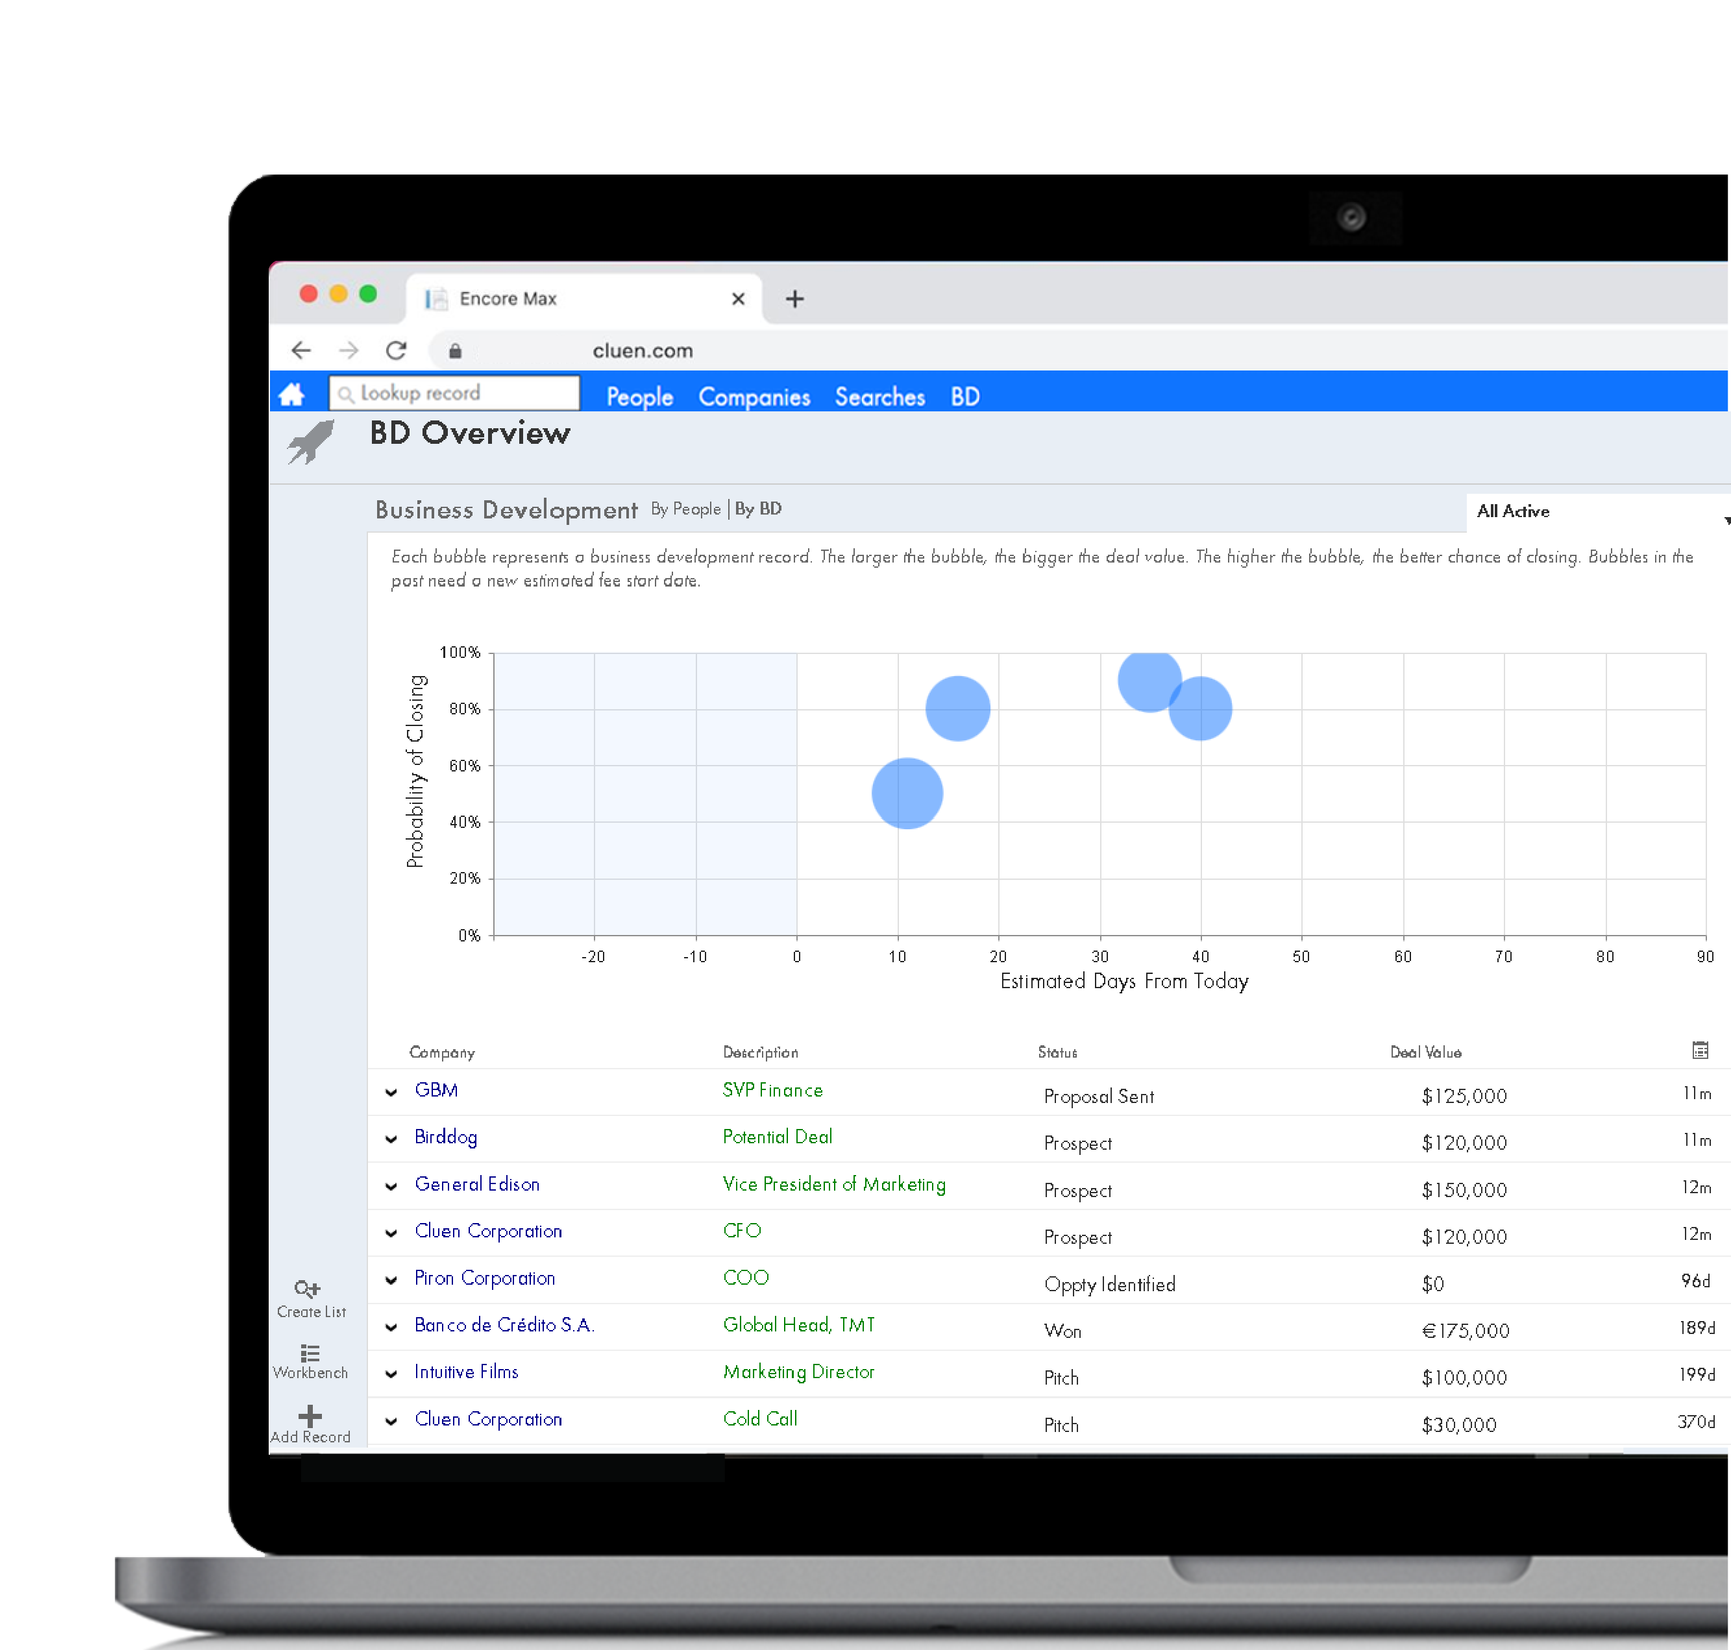
Pipeline Visualization
The BD dashboard, at a glance, allows you to:
Focus on your most important prospects
View a pipeline of potential business
Forecast revenues by consultant, practice, or whole team
Support your internal BD reporting and team meetings
Sample Spreadsheet
Notes:
As an example, Cluen’s software Encore, has a built-in pipeline tracker to help visualize your opportunities, plot future search work and forecast potential revenues.
What ever tool you use should have something to measure your upcoming work and efforts whether you’re in a team or on your own.
Even if you don’t have a system like Encore, you can still track your opportunities in a spreadsheet .

Slide 8
Using AI in Business Development
Using AI to help drill-down into potential client needs using ChatGPT and annual reports
Produce content for Digital Marketing, newsletters, articles, education, blog
To automate email campaigns and outreach on LinkedIn- the same way you do for candidates
Notes:
You might remember in May we talked about using Generative AI to help focus BD efforts at target clients or prospects. I showed an example where I uploaded a company’s annual report and was able to get ChatGPT to identify where they might be hiring and highlights on their recent executive and board moves.
Another use for Gen AI is in content creation. One of the key collateral pieces used by marketers is content in the form of newsletters, articles, and education. With the assistance of ChatGPT you can quickly produce material to share with your target market.

Slide 9
Let's take a poll
Are you tapping into Generative AI to create content?
Yes
No

Slide 10
A Sequence That Works
Content
Email
Ads SEO SEM

Slide 11
A Sequence That Works
Content
Email
Ads SEO SEM

Slide 12
AI Content Generation
Save time and creative brain-power.
Buffer’s AI Assistant $5/month or free version
Narrato AI Content Genie $36/month for small teams with a free trial
These AI content creation tools will:
Suggest content ideas and generate text
Translate content into multiple languages, expanding your reach to global audiences
Repurpose your content to extend the life of valuable posts
Analyze engagement metrics, providing actionable insights to refine your content strategy
Monitor competitors' content and provide insights into their strategies
Schedule and automate posts to go live at optimal times
Notes:
One of the ways people connect with their audience it through content. The more relevant and consistent the better.
This can come in the form of:
Newsletters
Articles
Thought leadership
Case studies
AI content creation tools like Buffer or Narrato can help you create, optimize, and manage your content.
These are more specific than your everyday GPT tools because they can translate, repurpose your content,
analyze engagement metrics, monitor competitor content and schedule and automate posts to go live at optimal times.

Slide 13
Alternative Content Development
Hire a freelance content writer:
UpWork: Varies on the freelancer you choose
Fiverr: Varies on the freelancer you choose
FatJoe: Article writing starting at £10
WittyPen: £13 to £29 per piece
Notes:
"If you're still doing Marketing manually, you're leaving 80% on the table."
As an alternative to AI Content tools, you could outsource your efforts directly by hiring freelance content writers at an affordable price from companies like: UpWork, Fiverr, FatJoe, and WittyPen.
OR YouTube has tutorials on just about any new tool you can think of.

Slide 14
A Sequence That Works
Content
Email
Ads SEO SEM
Notes:
Now that we've gone over Content, how are we going to maximize delivery?
You probably email all day long, but do you send emails in bulk? at chosen times? to different groups? in different time zones?
And are you tracking who's engaging so you can prioritize your follow up?

Slide 15
Email Sequencing and Outreach Automation
Notes:
Here are some tools for email sequencing and outreach automation.
Some of these reach people on LinkedIn if you don't have their contact info.
If you're using a comprehensive executive search platform, like Cluen's platform Encore, you probably have built-in tools for managing your email marketing.

Slide 16
A Sequence That Works
Content
Email
Ads SEO SEM
Notes:
Finally, we get to our digital marketing piece. This is working 24/7 in the background and while you're researching. We'll talk about what powers your visibility on search engines and how to drive more traffic to your site.

Slide 17
Search Engine Optimization (SEO)
Enhance your website’s visibility on Google to attract more organic traffic. Optimize your content, keywords, and user experience to improve search rankings.
Organic search is free, and always working in the background for you.
A solid SEO strategy includes:
A Stellar Website
High-Quality Content
Trackable Conversions with Form Fills
A Clear CTA (call-to-action) Button for Leads!
Notes:
MARKETING is really just the art of creating visibility and driving traffic.
You may have heard of SEO, or SEM but what's the difference? and how can they each help attract more traffic to your site?
First, SEO: a free way to optimize your website and Google rankings.
A solid strategy includes:
Have a stellar website: A well-organized website with fast loading times and clear navigation enhances user experience and helps boost rankings.
Create High-Quality Content: In the content portion, we discussed regularly posting relevant blogs, case studies, or insights relevant to the industry to improve visibility and establish authority in the market. Consistency is key!
Track Conversions with Form Fills: Offer content that is free, but downloadable. Create an email sequence from this lead.
A clear CTA (call-to-action) button for people to convert to a lead!

Slide 18
Search Engine Marketing (SEM)
Promote your website through paid ads on Google or LinkedIn to increase visibility and drive traffic. Bid on keywords to ensure your ads appear when users search for relevant terms.
Paid search puts you in front of your audience right when they are searching for you.
​A strong SEM strategy includes:
Targeted Keywords and Ads
Geo-Targeting for Specific Locations
Clear, Compelling Ad Copy
Optimized Landing Pages for Conversions
Ongoing Performance Tracking and Adjustments
Notes:
SEM is Paid search that puts you in front of your audience right when they are searching for you. Great way to get new clients.
*We all know Marketing is a COST to the company, but proving its value is made easy when you can track and report on marketing analytics.
A strong SEM strategy includes:
Targeted Keywords and Ads
Geo-Targeting for Specific Locations – and I'll go over this in more detail shortly.
Clear, Compelling Ad Copy
Optimized Landing Pages for Conversions (Remember SEO tips from last slide? It all works together beautifully)
Ongoing Performance Tracking and Adjustments
*Google quality score goes up for relevant text that is found in your ads.
For example, when someone clicks an ad that says “Best executive search firm in the world,” it should also say that on your landing page to match.

Slide 19
Know Your Audience
Crucial so you can convey the exact right message to reach the right opportunities
Consider your budget to be a bucket of paint for your whole house. It is much better to focus on one room, or even an accent wall so the job comes out well done.
Notes:
Once you start building your budget, knowing your audience is crucial so you can convey the exact right message, and get quality leads.
Besides, you have a budget to manage if you're running paid ads (SEM), so you have to allocate those funds with intention.
Consider your budget to be like 1 bucket of paint... for your entire house. The walls would all come out very poorly.
But if you focus that one bucket for one room, or even a wall, that would be a job well done.
We spoke about Geo-Targeting in the last slide on SEM, so you can focus your budget on specific locations and even exclude others.
You can always work with what you've got.

Slide 20
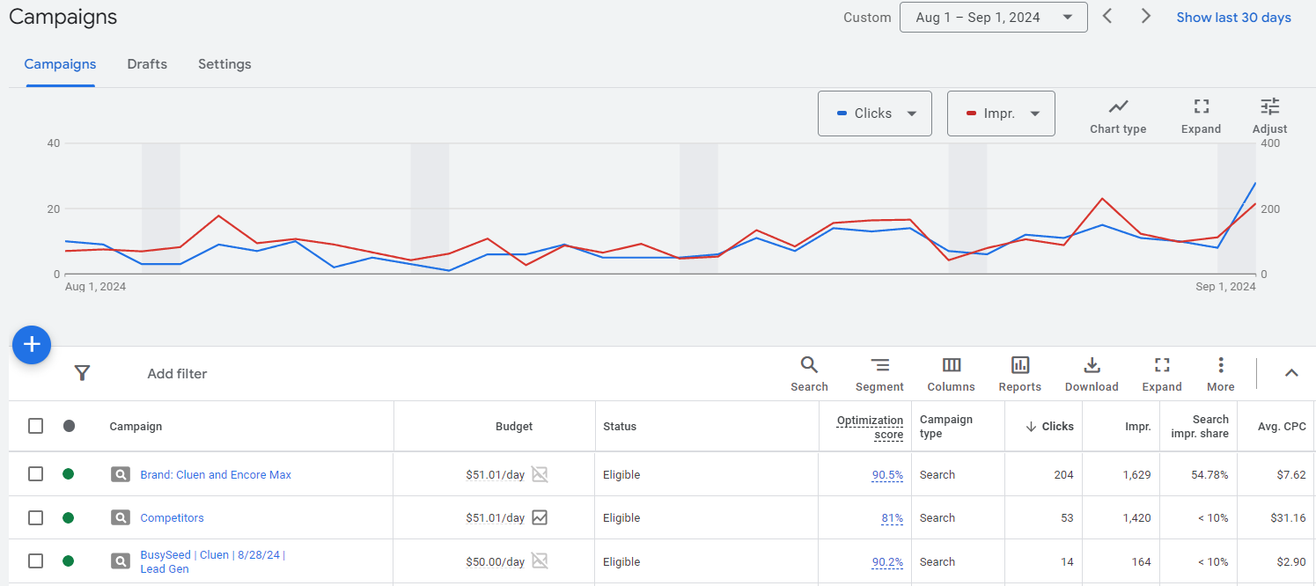
Google Ads
Get started in 5 easy steps! www.ads.google.com/how-it-works
Notes:
Paid Search Platforms! Google Ads.
If it looks complicated, it really isn't, and you can get started in 5 steps on this website.
You allot and manage the budget to run these Google ads.
This part is fun because you see the little changes you make ramp up, and benefit your metrics immediately.
REMEMBER, this is always running in the background while you're busy doing search work.
Tighten Up & Optimize:
Apply One-click Google recommendations to boost your optimization score which ranks you higher.
Specify and exclude locations.
Schedule ads for peak times (see when most people are searching and exclude the times they aren't think – rush hour traffic times) or just your time zone!
Bid higher for people searching on mobile devices. Usually see most traffic coming from mobile (usually is).
YouTube has a ton of helpful how-to videos.
LinkedIn Learning courses
Hire a 3rd party to run your digital marketing like BusySeed.

Slide 21
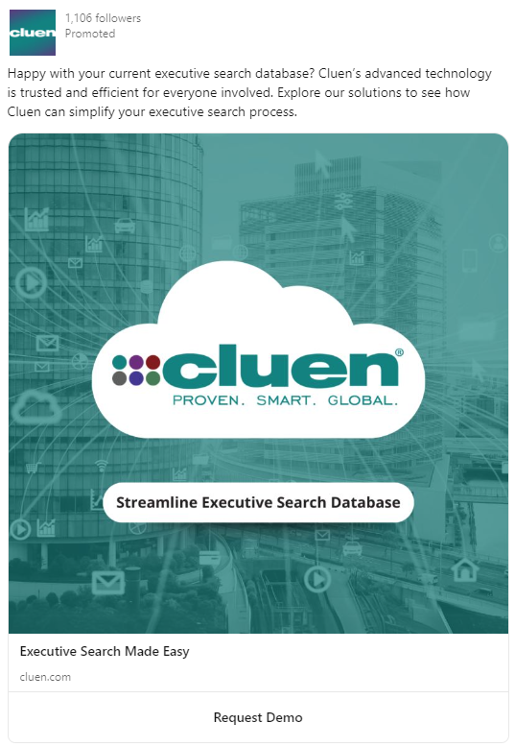
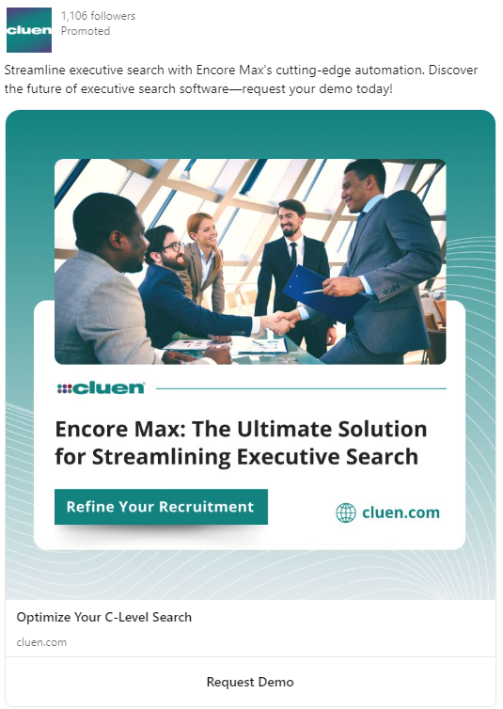
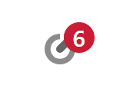
LinkedIn Ads
Notes:
LinkedIn Ads is another great platform to reach new opportunities. Access LinkedIn Ads by clicking the "advertise" target icon in the top right of your Linked In page.
Just like Google Ads, you control the budget. LinkedIn recommends building an audience of about 50,000 to 100,000 contacts, which is made easy with their filters and settings.
You can super target your audience by uploading a contact list, or a company list. Filter by industry role, seniority and more! Even hit "LinkedIn audience expansion" to grow it even more to others in the network.
***They even have reps that will offer 15 min meetings for quick help for free.***
Courses you can take to set this up: LinkedIn Learning
YouTube
Or again, hire a 3rd party like BusySeed

Slide 22
Campaigns That Work
Brand: Secure your firm's name keywords: "julie executive research group," "era executive research association."
Account Based Marketing (ABM): Highly sought after targets that you're nurturing. Stay top of mind so you are on their short-list when they have hiring needs.
Search Campaign: Reach people that are searching for your relevant keywords pertaining to your business. Example: Someone searching for "executive researcher" "executive search firm."
Retargeting: Cheap display campaign (visual ads) that follow the website visitor around until they convert (or take action) on your website.
Notes:
I like to always have these 4 campaigns running on Google and LinkedIn. All of these campaigns get you in front of the people that search for you either by name or by industry or what have you – keywords.
Brand: Secures your firm's NAME keywords so others can't buy it and bid on it (to show up ahead of you in rankings)
ABM: Account Based Marketing. Highly sought after targets that you're nurturing. Stay top of mind so are on the short-list when they have hiring needs.
Search Campaign: Reach people that are searching for your relevant keywords pertaining to your business. Example: Someone searching for "executive researcher" "executive search firm."
Retargeting: Cheap display campaign (visual ads) that follow the website visitor around until they convert (or take action) on your website.

Slide 23
Let's take a poll
Do you send out client or candidate surveys?
Yes
No

Slide 24
Leveraging Surveys
Client Satisfaction Surveys
Collect data and create compelling content
Send a market survey on job satisfaction, compensation and culture. Share the results back to the executives who participated.
Bonus! You're also getting your name in front of candidates.
Notes:
Sending surveys is another opportunity to engage your targets, clients, and candidates. Make it so they see your brand again in their inbox.
A Client Satisfaction survey can reaffirm you’ve provided a great service, so the client is likely to choose you again for future search needs.
Surveying your market is another way to fuel your content creation, build your credibility and presence in your industry, and give people a reason to be waiting for your survey results to hit their inbox.
For example: one of our clients every year does an annual survey of all CFOs in their market sector across the United States. They share trends year over year around compensation, job satisfaction, even likelihood to change jobs that year. This can even be helpful for candidate development.

Slide 25
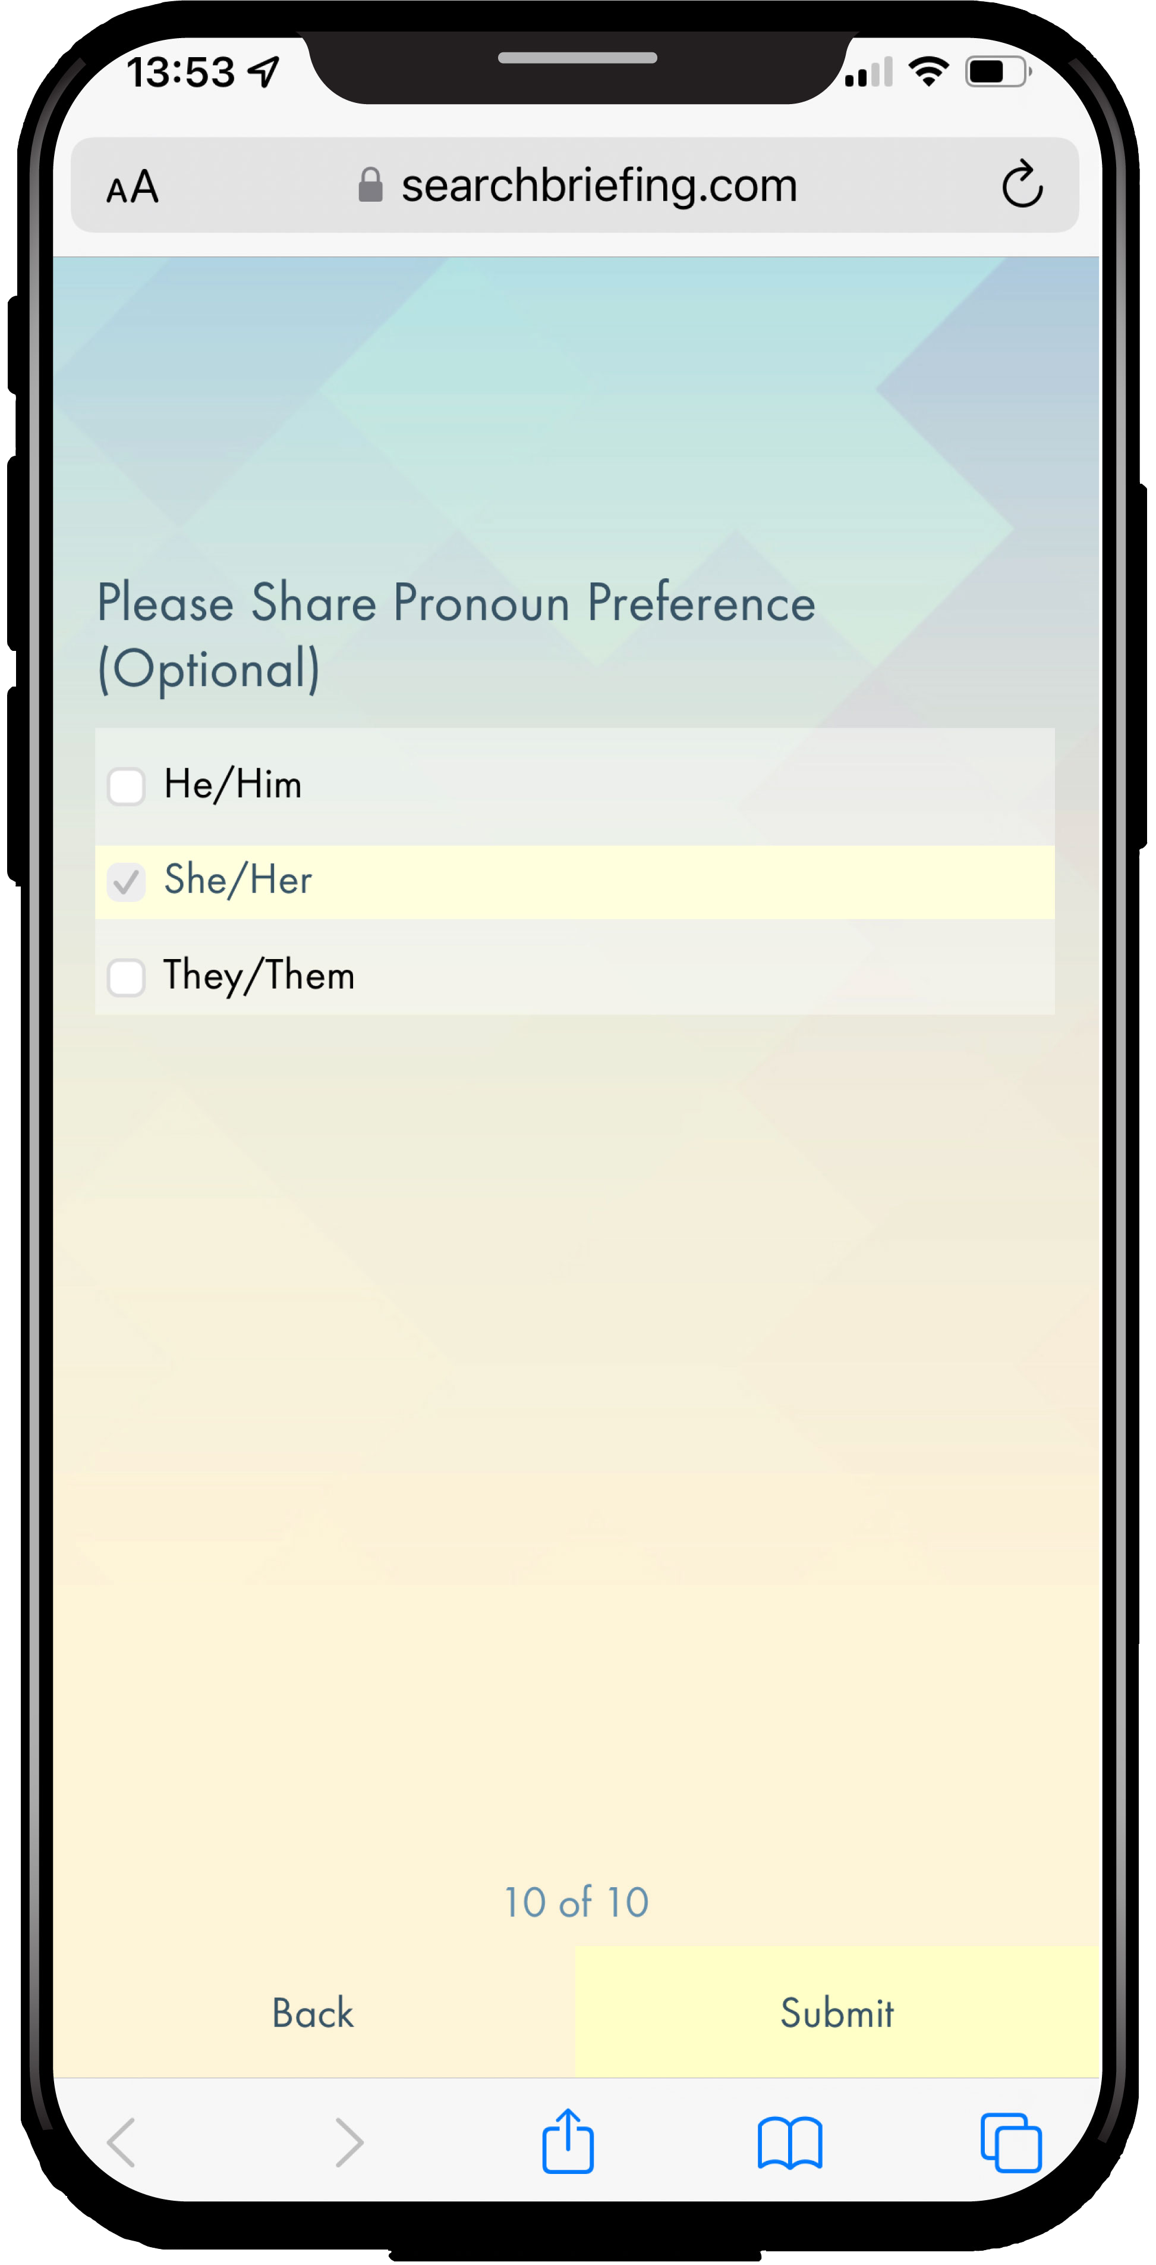
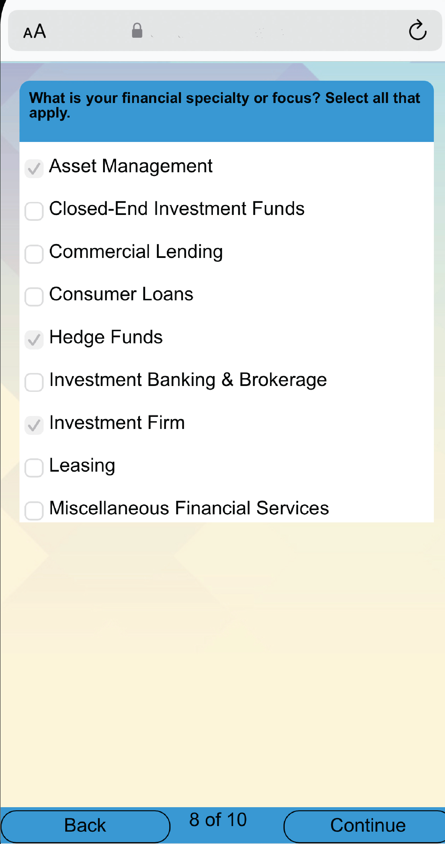
How Cluen Sends Surveys
We send out a yearly survey in May with an incentive prize.
We collect the data to tell the story of this year's recent and most important technology trends in the industry.
There are tools out there like SurveyMonkey, MailChimp, Typeform
Encore users have a built-in survey tool that saves data directly to contact records
Notes:
So once again, this is an easy way to collect data for content.
Internally, we send out our yearly survey in May, with an incentive prize to get the most respondents and the data we collect, we transform into our yearly white paper.
There are tools out there like SurveyMonkey, MailChimp and Typeform.
Encore users have a built-in survey tool that saves data directly to contact records.

Slide 26
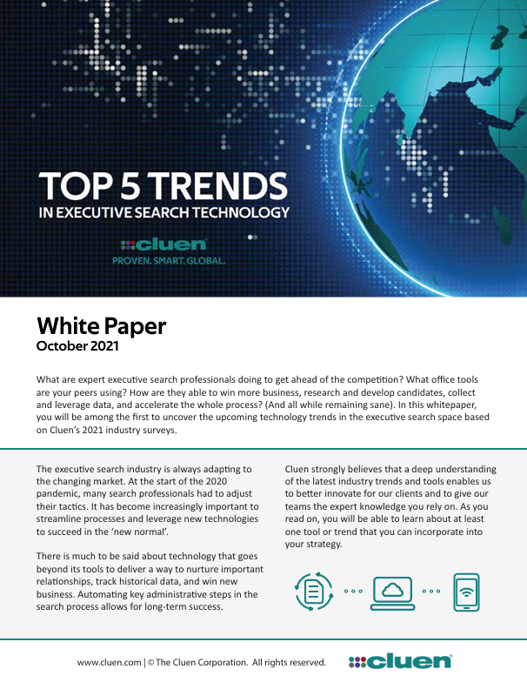
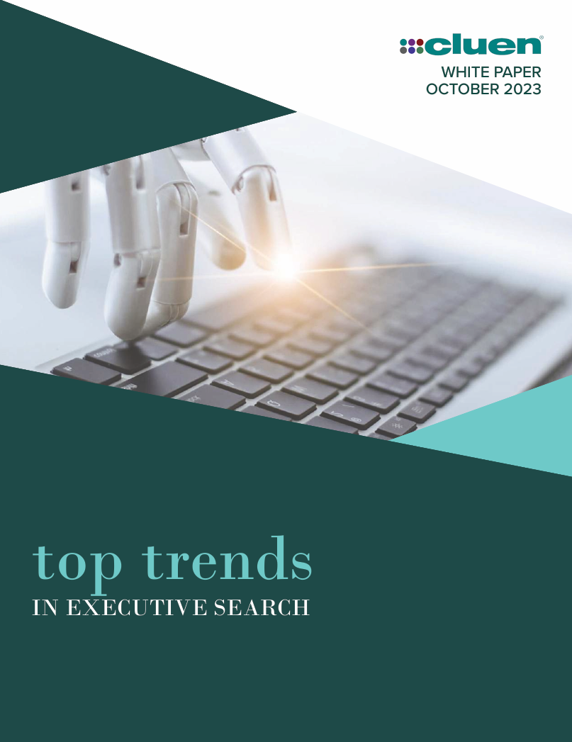
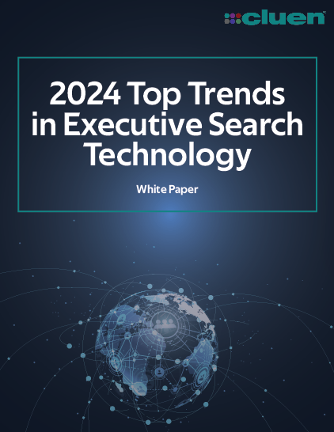
White Paper Preview
Are you familiar and equipped with the tech tools your peers are using?
Here's a sneak peek of our upcoming white paper publishing in October.
Notes:
-----JULIE-----
Here's an example of a completed content piece. *SHOW 2023 WHITE PAPER*
Every year, we take the respondent data from our survey, and put it in our white paper where we uncover the secrets behind what tech tools your peers are using.
It's publishing in the next couple weeks, you'll all get an invite to download it.

Slide 27
Does your firm use any third-party research tools?
Swordfish.ai
Apollo.io
LinkedIn Sales Navigator
RocketReach
Boardex
S&P Capital IQ
LinkedIn Recruiter
ChatGPT
Pitchbook
Google/Boolean Search
Engage AI
APQC
ContactOut
Phantom Buster
None
ZoomInfo
Sales QL
Seamless.ai
Owler by Crunchbase

Slide 28
What Generative AI products is your firm using?
Apollo.io
Google Gemeni
Midjourney
ChatGPT
Claude
Monica
Dialpad
None
Microsoft Copilot
Safebrain
Seamless.ai

Slide 29
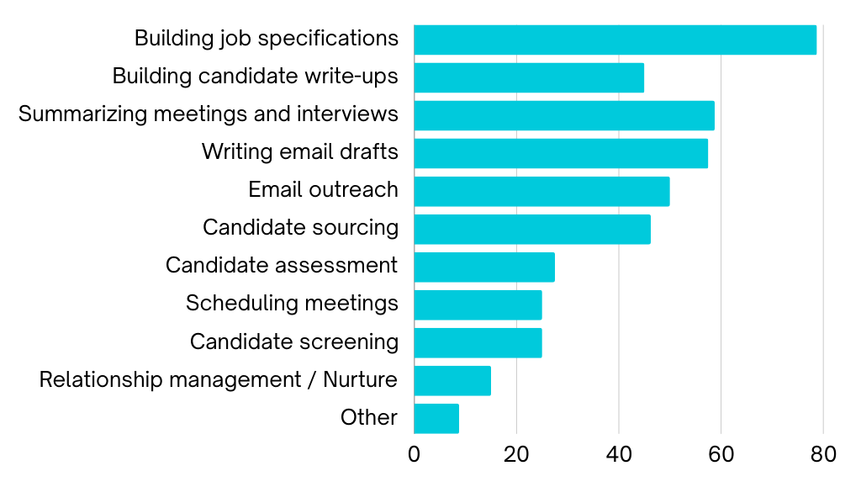
For what business processes might you use AI?

Slide 30
Will your firm be taking any of these AI training courses?
Internal training
SocialTalent
TBC
AIRS
Google courses
LinkedIn Learning
YouTube
Coursera
Independent consultant
College or University program
Udemy

Slide 31
Let's Recap
If you can, standardize on a single system to manage BD and Candidate flow.
Measure your pipeline – even if it’s in a spreadsheet!
Harness the power of AI to help develop content and automate outreach.
Visit your SEO and SEM strategies to drive more traffic.
Check out Google and LinkedIn to run your ads.
Stay tuned for upcoming white paper publishing next month!

Slide 32
Thank you

