Slide 1
Breaking our LinkedIn Addiction
Vanessa Raath
van@vanessaraath.com
www.vanessaraath.com

Slide 2
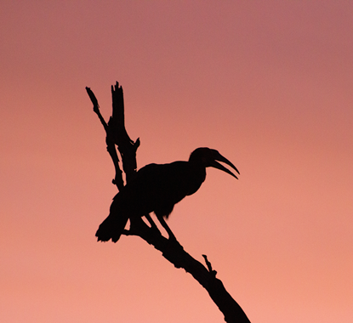
Who am I?
2
Global Sourcing Trainer & Sourcing Specialist
Passionate about Personal Branding
International Keynote Speaker
Budding Wildlife Photographer
@Van_Raath

Slide 3
Could you do your current job if LinkedIn disappeared tomorrow?
@Van_Raath

Slide 4
Over the past 5 to 7 years:
Have you noticed a decline in the response rate to your InMails?
Are you finding that you keep on viewing the same profiles?
@Van_Raath

Slide 5
Why do we need to stop being so reliant on LinkedIn?
Not everyone is on LinkedIn
There are a lot of professionals who are tired of being continuously harassed, and spammed, on LinkedIn which is why they are leaving the platform
Not everyone on LinkedIn is an active user
There are a lot of abandoned profiles on LinkedIn, so the information is no longer relevant
@Van_Raath

Slide 6
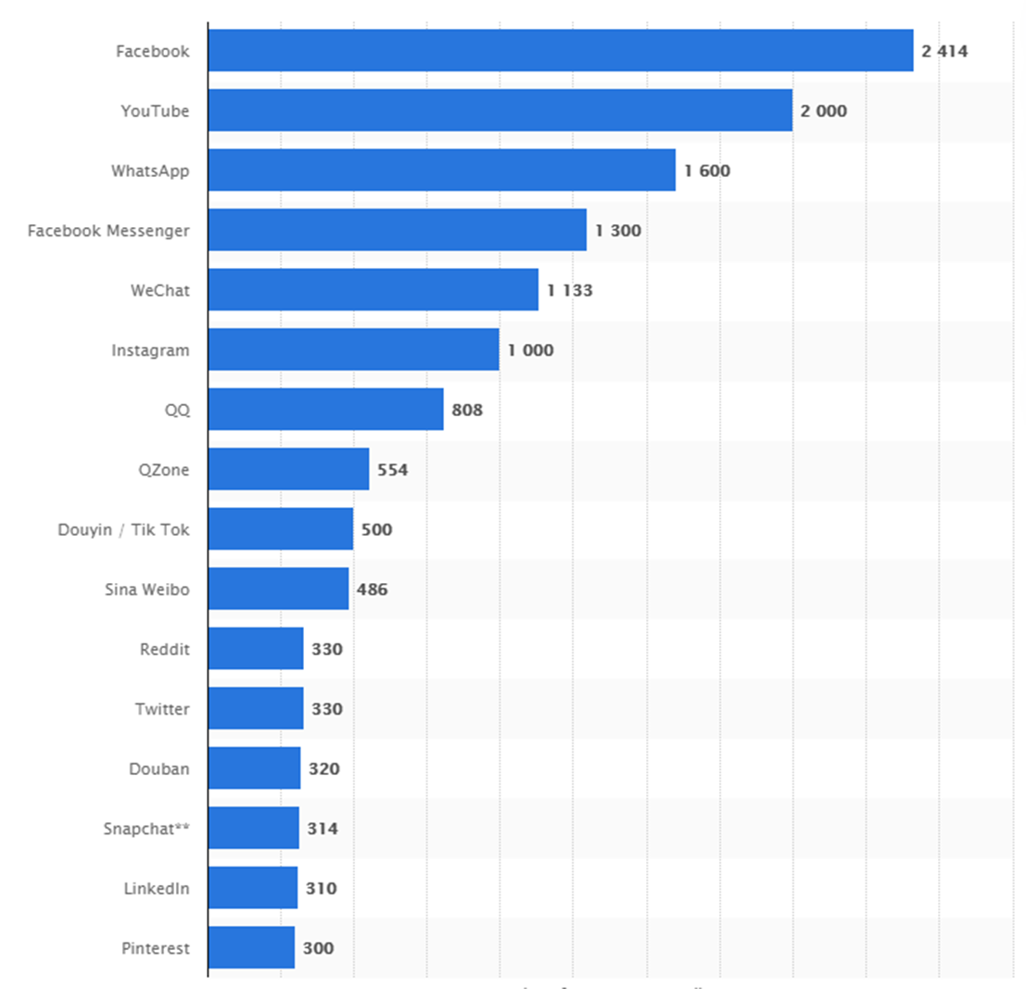
Most popular Social Networks worldwide as of October 2019, ranked by number of active users (in millions)
@Van_Raath

Slide 7
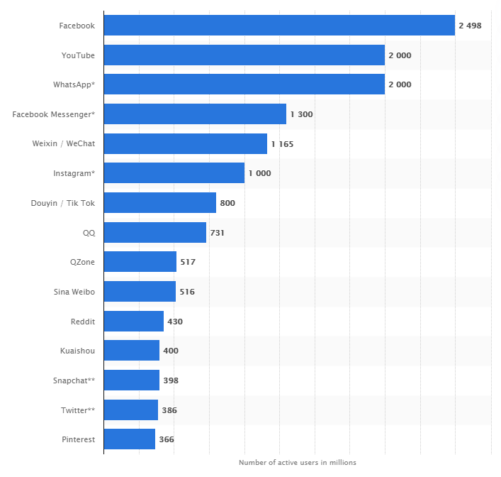
Most popular Social Networks worldwide as of April 2020, ranked by number of active users (in millions)
@Van_Raath

Slide 8
Can you name the top 3 countries represented on LinkedIn?
@Van_Raath

Slide 9
USA – 160 million users
India – 65 million users
China – 50 million users
Brazil – 45 million users
UK - ?? million users
- Statista April 2020

Slide 10
How many people currently live in the UK?
@Van_Raath

Slide 11
The United Kingdom 2020 population is estimated at 67,886,011 people at mid-year according to UN data - worldometer.com
How many of these people are on LinkedIn?

Slide 12
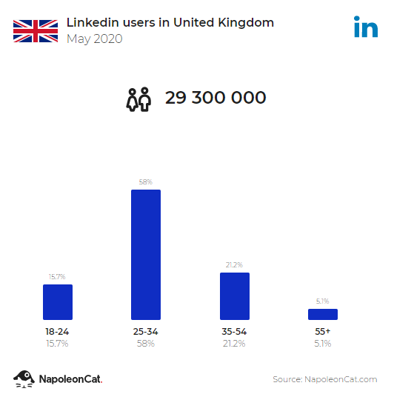
There were 29 300 000 LinkedIn users in UK in May 2020, which accounted for 43.4% of its entire population
People aged 25 to 34 were the largest user group (17 000 000)

Slide 13
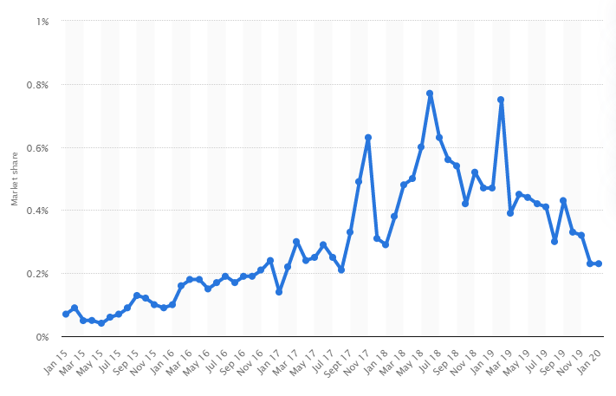
Social Network Web visit share held by LinkedIn in the UK from January 2015 to January 2020
Average = 0.23%
-Statista
@Van_Raath

Slide 14
MAU – Monthly Active Users

Slide 15
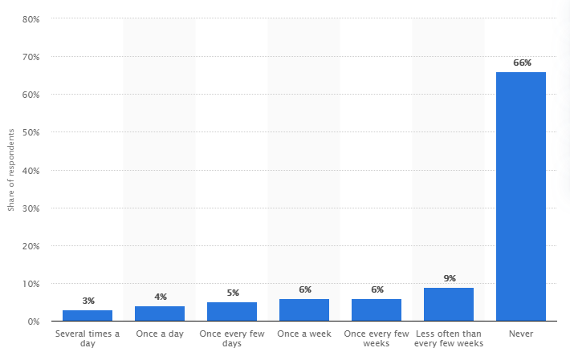
Frequency of LinkedIn Users in the UK in January 2018 - Statista
@Van_Raath

Slide 16
Love Hate Relationship
LOVE
Get loads of professional information
Easy to use
Great networking tool
HATE
Expensive when purchasing licenses
People use the platform badly
LinkedIn is too controlling of our behaviour

Slide 17
We go wrong when we START and END our searches on LinkedIn
@Van_Raath

Slide 18
LinkedIn needs to be part of your research strategy, but not the only part!
It would be ridiculous to ignore this platform altogether!
@Van_Raath

Slide 19
So where should we start our search?
@Van_Raath

Slide 20
When looking for a Cloud Architect in London:
site:linkedin.com/in "Cloud Architect" AND London

Slide 21
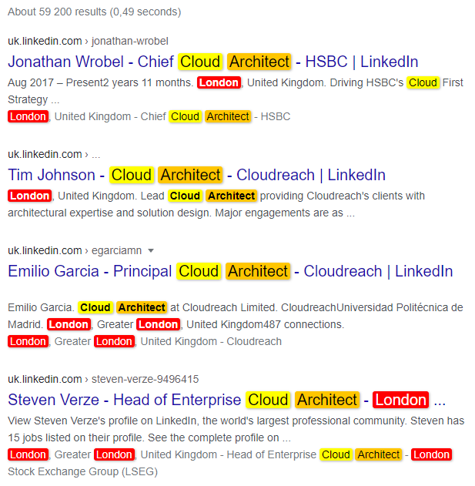
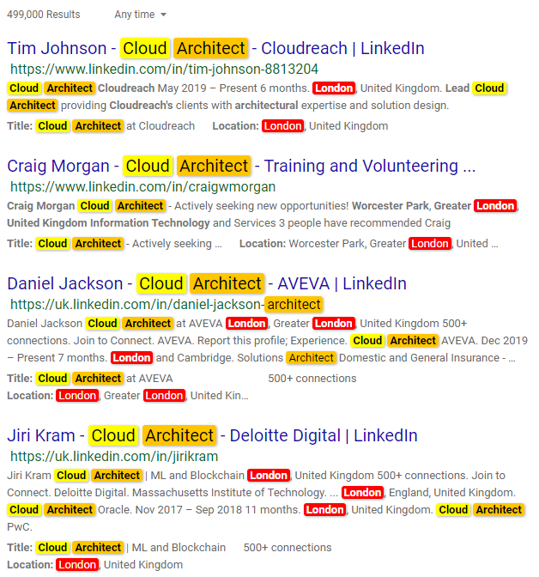
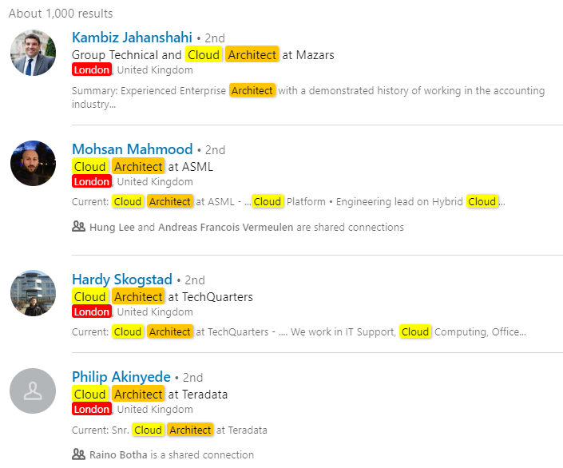
LinkedIn vs Google vs Bing
1000 results
59 200 results
499 000 results

Slide 22
How many words can you put into a Google search?

Slide 23
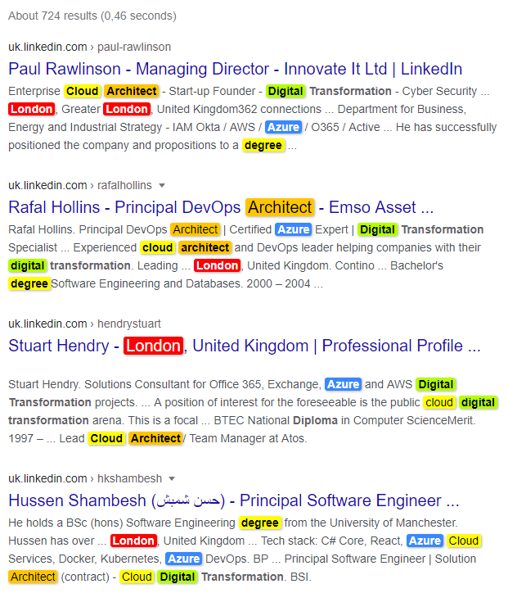
site:linkedin.com/in "cloud architect" AND London AND azure AND degree AND "digital transformation"

Slide 24
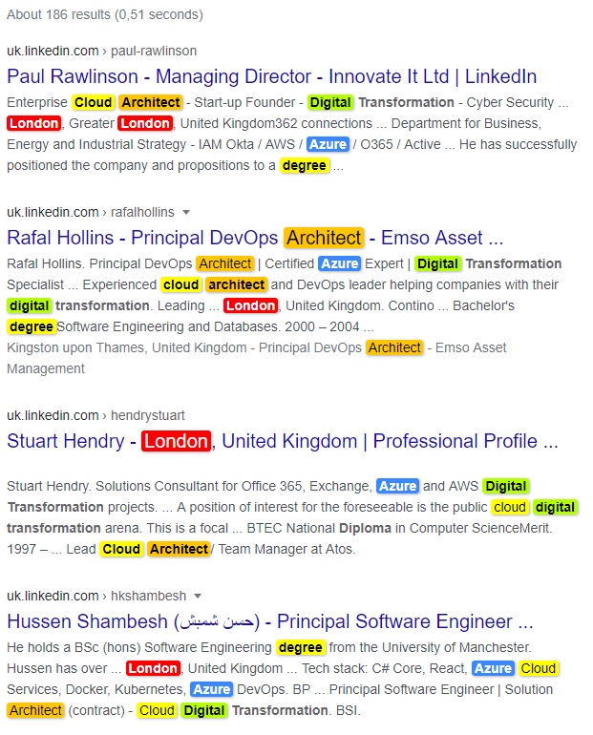
site:uk.linkedin.com/in "cloud architect" AND London AND azure AND degree AND "Digital Transformation"

Slide 25
What if we started our search on a different social platform & then cross-referenced the candidates on LinkedIn?

Slide 26
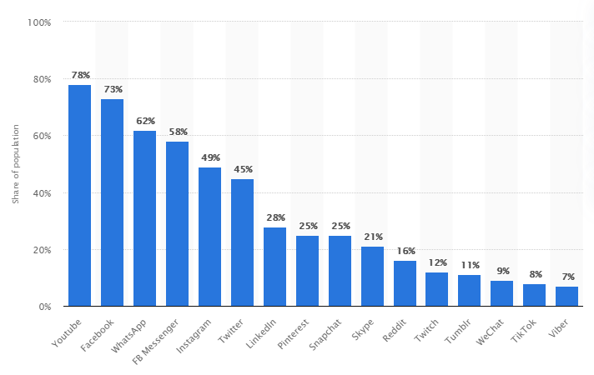
Usage penetration rate of Social Networks of active internet users in the United Kingdom (UK) as of Q3 2019
@Van_Raath

Slide 27
Leading countries based on Facebook audience size as of April 2020 - Based in millions - Statista
@Van_Raath

Slide 28
65 Results
site:facebook.com ("others named" or "others with") and “financial accountant" and London

Slide 29
1 100 Results
site:facebook.com “to present” AND “Financial Accountant” AND London

Slide 30
1 200 Results
site:facebook.com "profile photo" AND “Financial Accountant” AND London

Slide 31
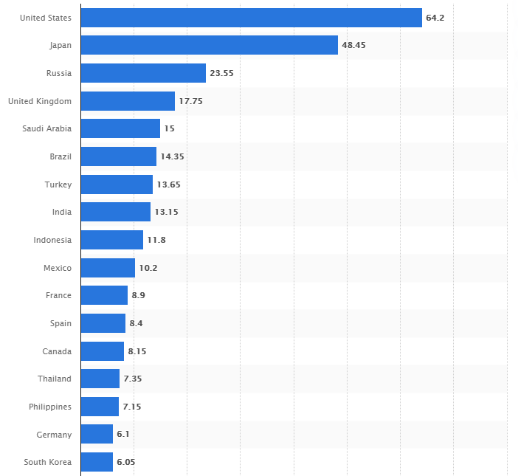
Leading countries based on number of Twitter users as of April 2020 - Based in millions - Statista
@Van_Raath
This Photo by Unknown Author is licensed under CC BY

Slide 32
22 500 results
site:twitter.com "software developer" AND London

Slide 33
5 030 results
site:twitter.com "software developer" AND London -status

Slide 34
www.followerwonk.com

Slide 35
Leading countries based on Instagram audience size as of April 2020 - Based in millions - Statista
@Van_Raath

Slide 36
571 results
site:instagram.com "Marketing Director" AND London

Slide 37
Which other social media platforms could we look on to find these people?
@Van_Raath

Slide 38
Tools to view Candidate’s Internet Footprint
Chrome Extension: AmazingHiring

Slide 39
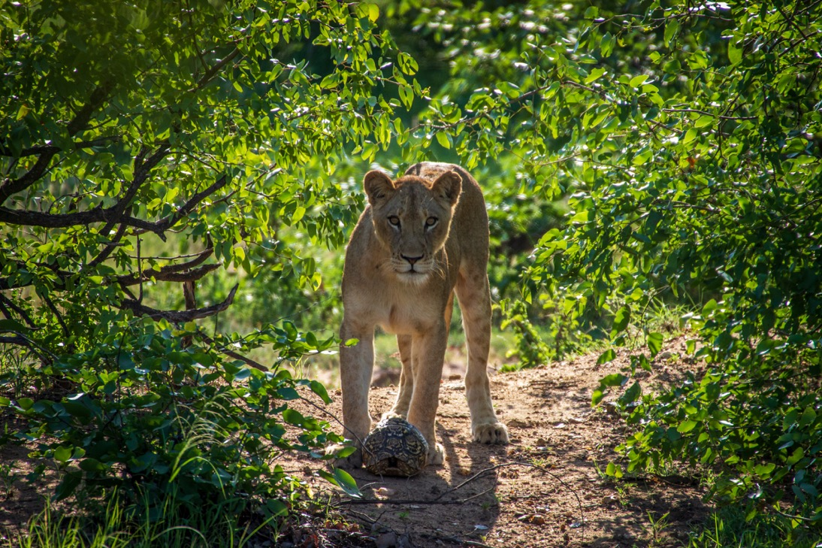
THANK YOU
www.vanessaraath.com
Vanessa Raath
+27 78 4600 189
van@vanessaraath.com

